Slide 1
ML MINI PROJECT Fake reviews detection using Machine Learning Algorithms
BY
PRATIMA CHINTA(CB.SC.P2AIE23021)
SNEHA NAIR (CB.SC.P2AIE23022)

Slide 2
CONTENTS
Description of the project
Problem statement
Model diagram
Preprocessing
All regression models
Clustering algorithms
Bayesian algorithm
Decision Tree
Neural networks

Slide 3
Problem statement
In an era of online commerce and digital platforms, user reviews and ratings play a crucial role in influencing consumer decisions. However, spreading of fake reviews poses a significant challenge, as they can mislead consumers and harm the reputation of businesses.
For the selected dataset, we will develop a model that can automatically identify and filter out deceptive reviews from genuine ones using supervised and semi-supervised machine learning algorithms and evaluate and compare them.
This project is motivated by the need of ensuring a fair and reliable online review ecosystem.

Slide 4
Dataset Description
Tabulation: 1600 rows × 5 columns
A dataset which comprises 1600 reviews has been selected, of which:
800 show favorable sentiment polarity and,
remaining 800 show negative sentiment polarity.
400 of the 800 reviews with favorable sentiment polarity are genuine and remaining 400 are fraudulent.
400 of the other 800 evaluations with negative emotion polarity are honest and remaining 400 are fake reviews.
https://www.kaggle.com/code/sachinsharma1123/deceptive-reviews-classification-acc-91/input
Columns:
deceptive(truthful or deceptive)
hotel (name of hotel)
polarity (positive or negative)
source (website it is taken from)
text (the review text)

Slide 5
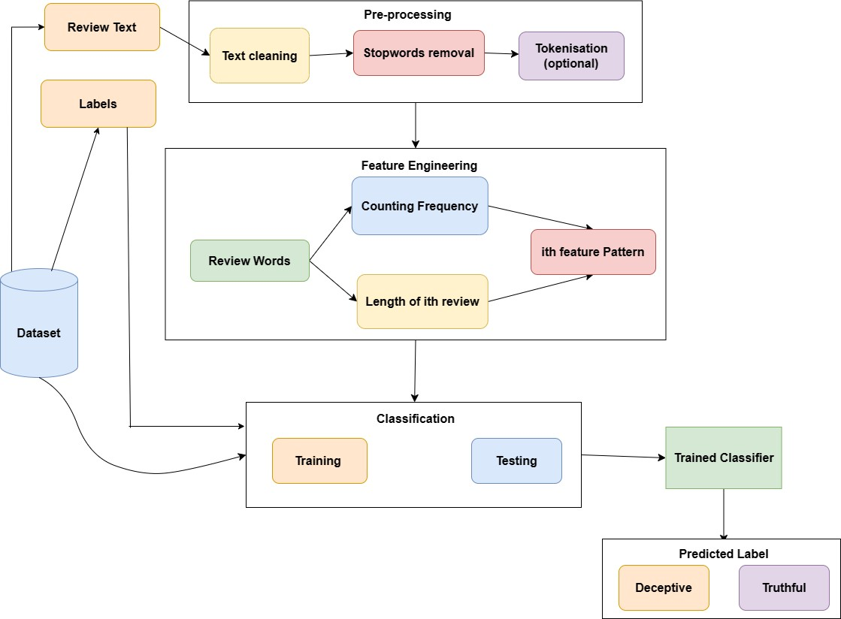
Model Diagram :

Slide 6
Preprocessing
Cleaning the Text Data:
Removing Stop words: Stop words are common words that do not add much meaning to a text. They are often removed from text data because they can increase the dimensionality of the data and make it more difficult to train NLP models.
Removing Punctuation: Punctuation can also be considered noise in text data. It can be removed from the text using regular expressions or other string manipulation techniques.
Text Normalization: It involves converting all text to lowercase or uppercase, removing extra whitespace, and converting numbers to their word forms. This can help to improve the consistency of the data and make it easier to match words together.

Slide 7
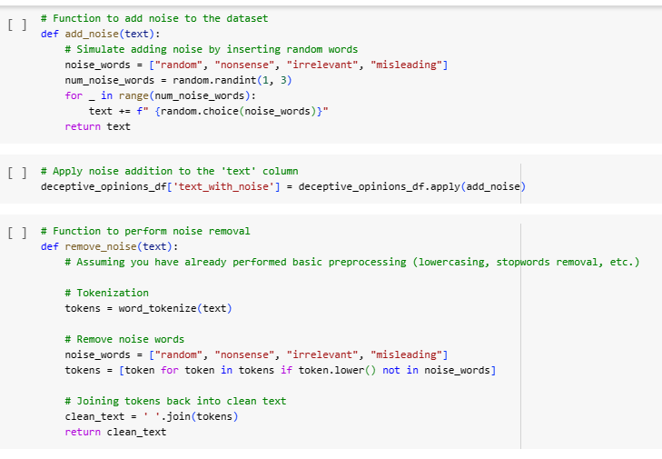
Preprocessing
Noise removal
Noise can produce inconsistent results if uncleaned data is fed to machine learning models. Therefore, it is crucial to remove noise from the text data before feeding it to the model to reduce unnecessary computation and provide clean data.

Slide 8
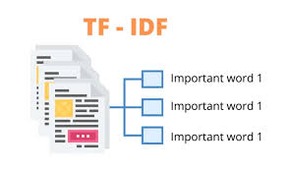
Preprocessing
Feature engineering techniques:
TF-IDF (Term Frequency-Inverse Document Frequency): Convert text data into numerical vectors that reflect the importance of words in a document relative to the entire dataset.
One hot encoding
representing categorical variables as binary vectors

Slide 9
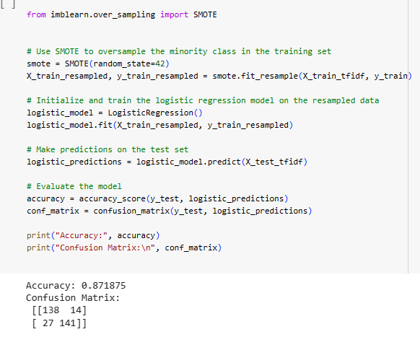
Preprocessing
SMOTE algorithm
(Synthetic Minority Over-sampling Technique) is a technique used to address class imbalance in classification problems by oversampling the minority class

Slide 10
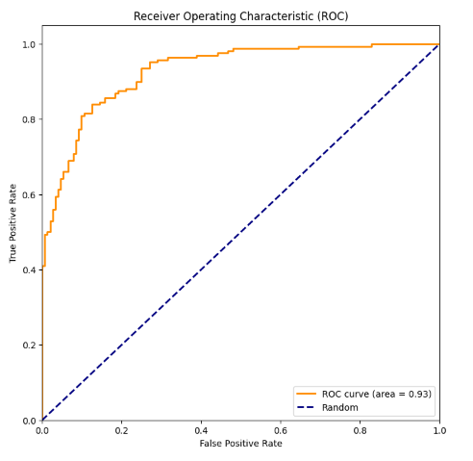
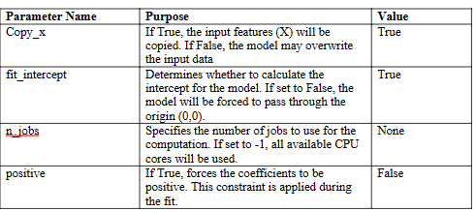
1. Regression Models
Linear regression model

Slide 11
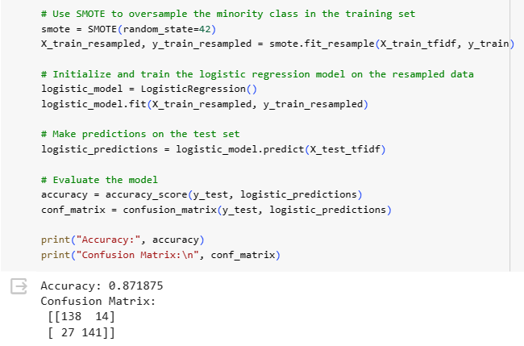
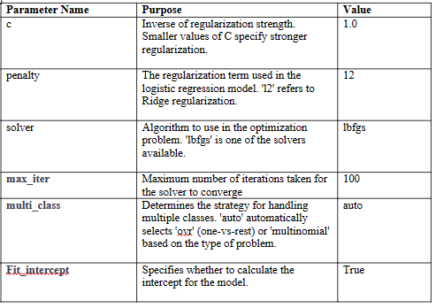
Logistic regression model

Slide 12
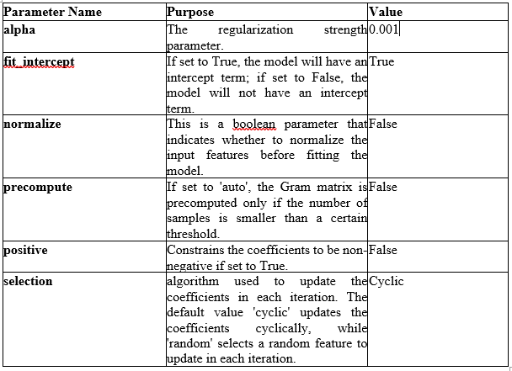
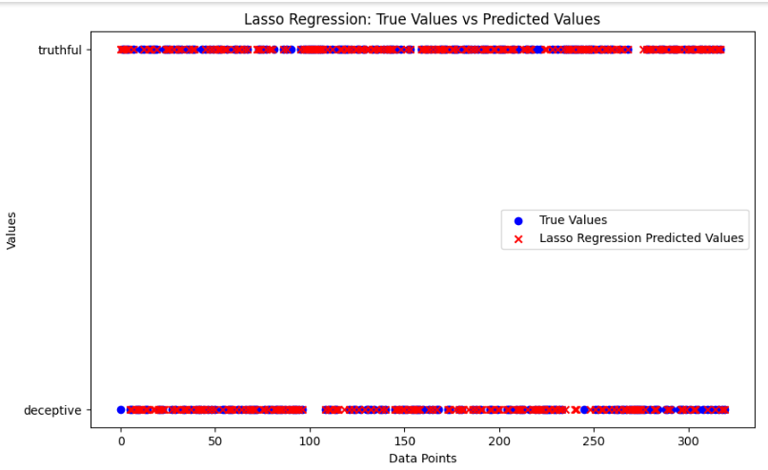
Lasso Regression

Slide 13
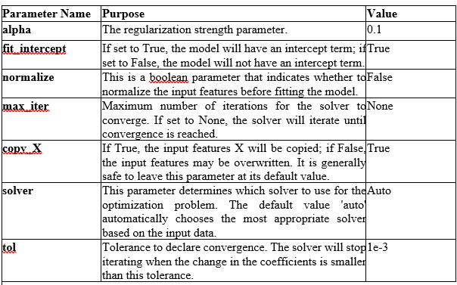
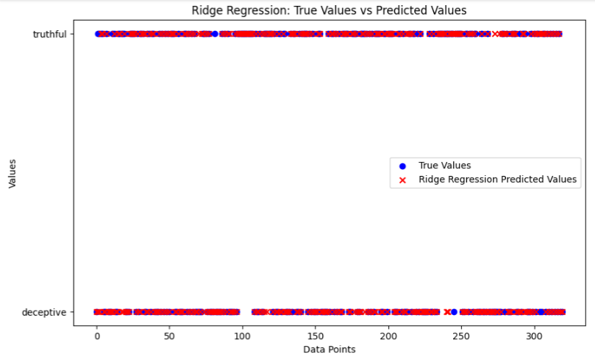
Ridge regression

Slide 14
Comparison of all Regression Models:
Model | MSE | Accuracy | Precision | F1 | Recall
Linear | 0.153125 | 0.846875 | 0.87898089 | 0.8492307 | 0.821428
Logistic | - | 0.871875 | 0.909677419 | 0.873065 | 0.8392857
Ridge | 0.11875 | 0.88125 | 0.91666 | 0.882716 | 0.851190
Lasso | 0.21875 | 0.78125 | 0.7916666 | 0.7916666 | 0.7916666

Slide 15
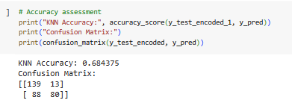
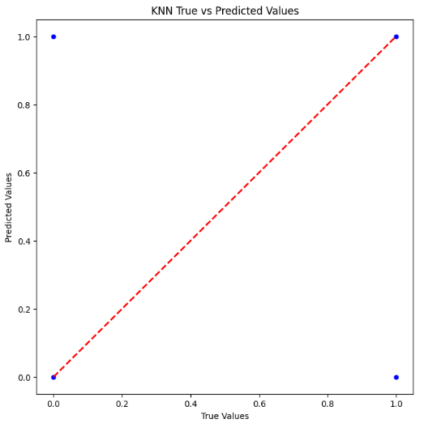
2. Clustering + Classifier Models
K-Means with KNN- no of clusters for k-means=2, no of neighbours for knn=9, remaining parameters are default.

Slide 16
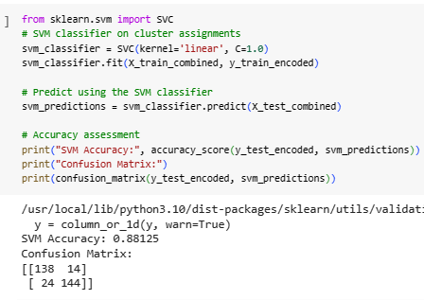
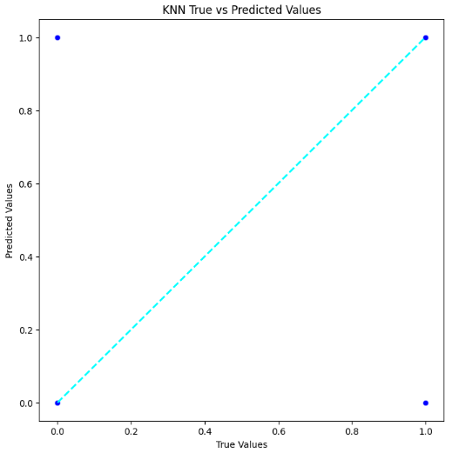
2. Clustering + Classifier Models
K-Means with SVM:
no of clusters for kmeans=2
Svm parameters:
C=1.0, kernel=‘rbf’

Slide 17
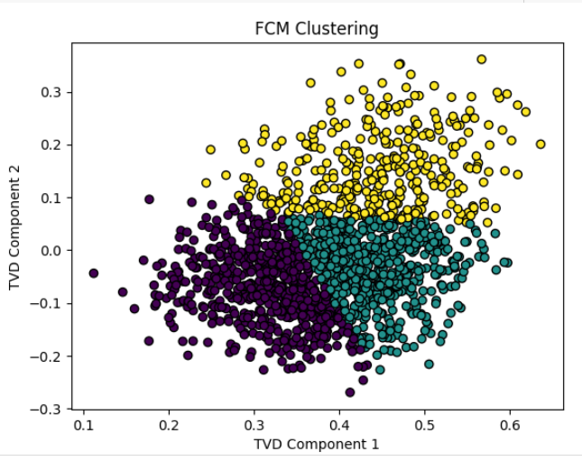
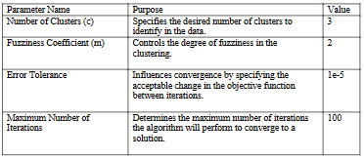
Clustering + Classifier Models
Fuzzy C- Means with KNN
Output for F-Cmeans clustering

Slide 18
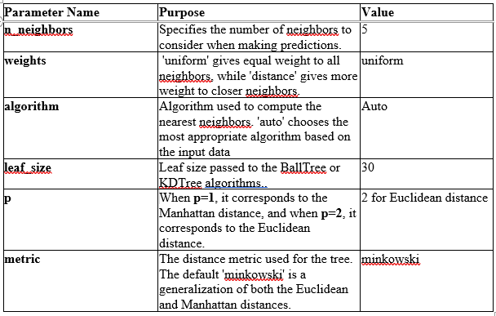
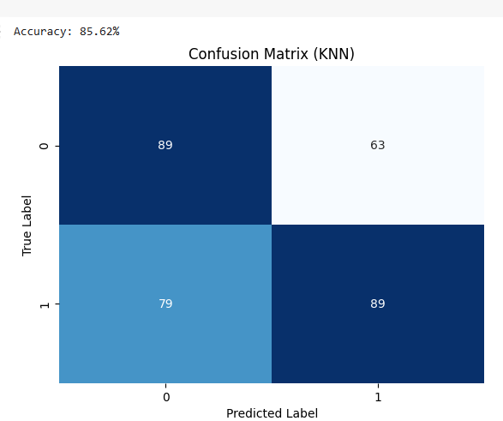
Clustering + Classifier Models
Fuzzy C- Means with KNN
Output of KNN

Slide 19
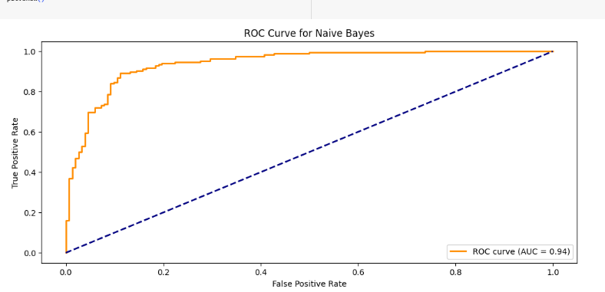
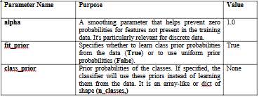
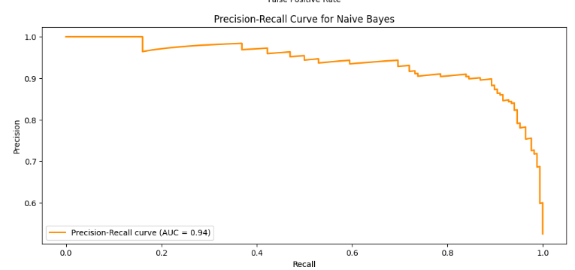
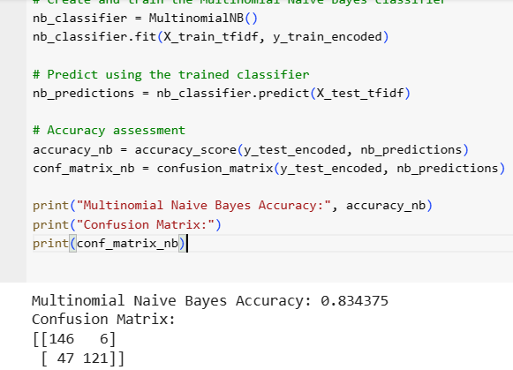
Bayesian Classifiers: Multinomial Naïve Bayes
Output of Naive bayes

Slide 20
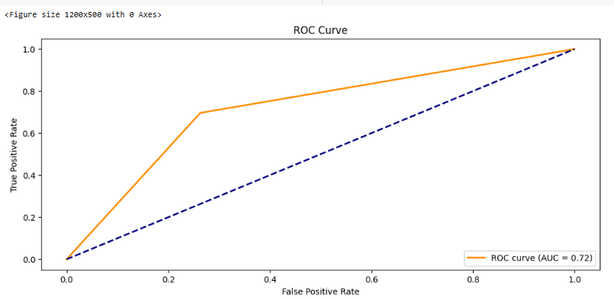
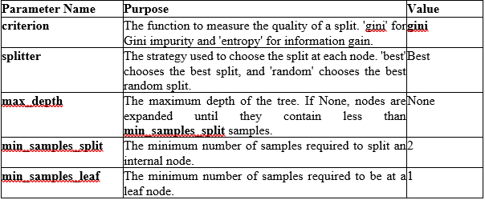
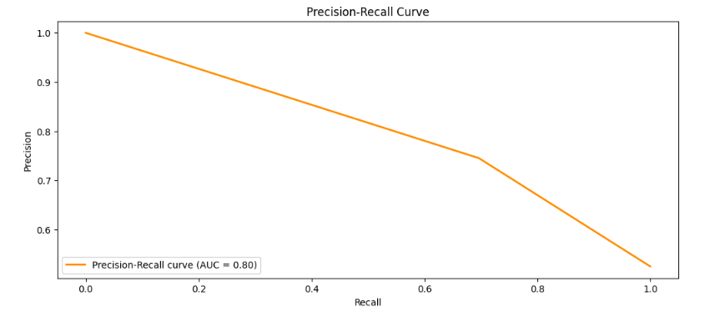
Decision Tree Classifier

Slide 21
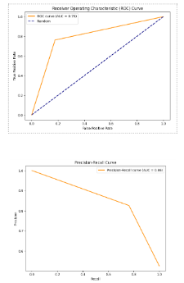
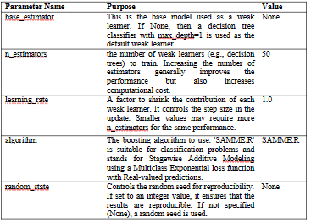
Adaboost Classifier

Slide 22
Comparision of Clustering plus Classifiers and other classifiers:
S.no | Algorithm Name | Split Ratio | Accuracy | Precision | Recall
1 | KMeans with KNN | 80:20 | 0.684375 | 0.868131 | 0.47023809
2 | Fuzzy C-Means with KNN | 80:20 | 0.8562 | 0.56 | 0.56
3 | KMeans with SVM | 80:20 | 0.88 | 0.911392 | 0.8571428
4 | Multinomial Naive Bayes Classifier | 80:20 | 0.85625 | 0.86 | 0.86
5 | Gaussian Naive Bayes Classifier | 80:20 | 0.646875 | 0.65 | 0.65
6 | Decision Tree | 80:20 | 0.715625 | 0.72 | 0.72
7 | Adaboost | 80:20 | 0.790625 | 0.8358 | 0.76190

Slide 23
3. Neural Network Models- K – Means with Convolutional Neural Network
Parameter values chosen for k means:
n_clusters=8, init=’kmeans++’, n_init=10, max_iter=300, tol=1e-4, random_state=42
S.No​ | Parameter Name​ | Value​
1​ | Learning Rate​ | 0.001​
2​ | Number of Batches​ | 5​
3​ | Batch Size​ | 32​
4​ | Number of Convolution layers​ | 3
5​ | Number of Kernels/Filters​ | 64​
6​ | Kernel size​ | (3​,3)
7​ | Stride​ | (1,1)​
8​ | Padding​ | ‘valid’
9​ | Pooling Type​ | Max-pooling​
10​ | Pooling size​ | (2,2)
S.No​ | Parameter Name​ | Value​
11​ | Activation function​ | Relu​
12​ | Dropout rate​ | 0.2​5
13​ | Optimizer​ | ‘adam’​
14​ | Loss function​ | ‘binary_crossentropy’
15​ | Input shape​ | 5001
16​ | Output layer configuration​ | Sigmoid activation function​​
17​ | Batch Normalization​ | Not used
18​ | Weight initialization method​ | Xavier uniform

Slide 24
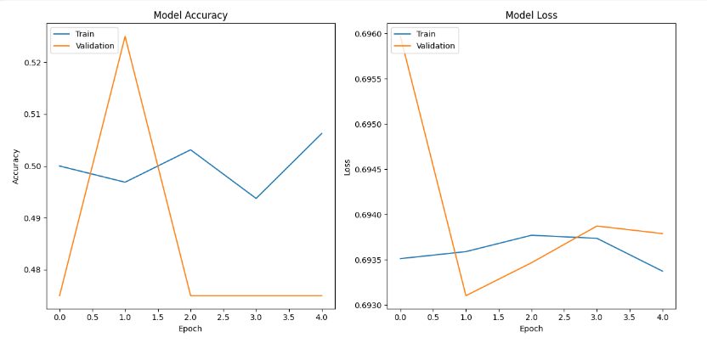
K – Means with Convolutional Neural Network Results

Slide 25
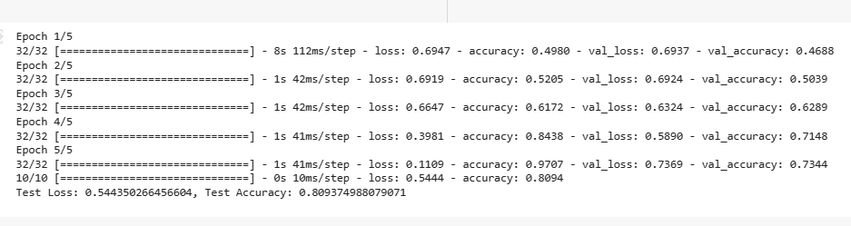
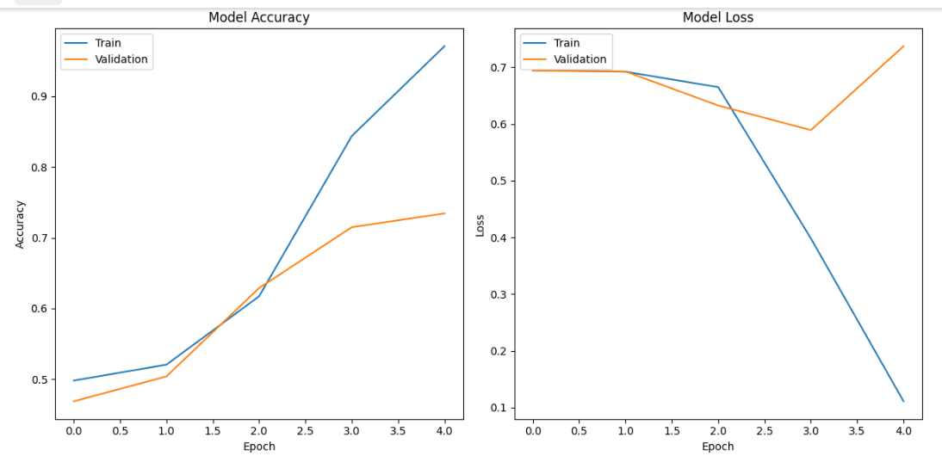
Convolutional Neural Network

Slide 26
Long Short-Term Memory Recurrent Network
Parameter Name | Purpose | Value
Units | Number of hidden units in the LSTM layer, defining its complexity and capacity. | None
Activation function | Controls how the output is transformed, with tanh providing a smooth S-shaped curve between -1 and 1. | tanh
Recurrent dropout | Regularizes the model by randomly dropping some recurrent connections, preventing overfitting. | 0.0
Return sequences | Determines whether to return the full output sequence or only the final hidden state | false
Seed | Random seed for dropout, ensuring reproducibility across training runs. | None
Kernel initializer | Specifies the initial weights for the LSTM layer. | glorot_uniform
Bias initializer | Initializes the biases of the LSTM layer to zero. | 0
State initializer | Initializes the initial state of the LSTM layer. | orthogonal
Kernel regularizer | Applies a penalty to the weights during training to prevent overfitting. | None
Bias regularizer | Applies a penalty to the biases during training to prevent overfitting. | None
Activity regularizer | Applies a penalty to the output of the LSTM layer during training to prevent overfitting. | None

Slide 27
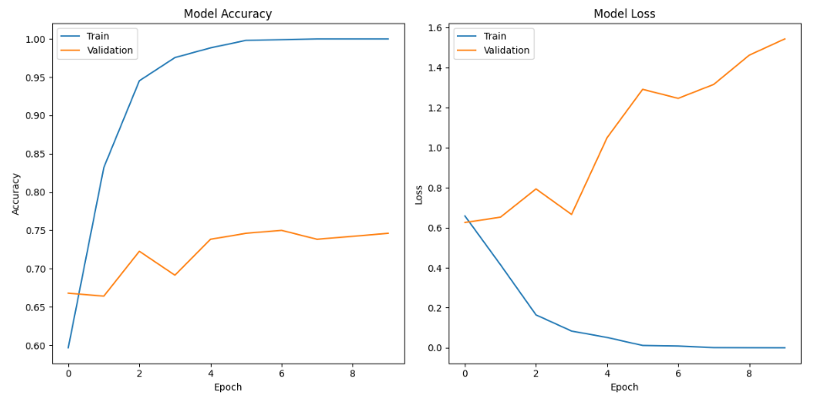
LSTM Results

Slide 28
GRU- Gated Recurrent Unit
Parameter Name | Purpose | Value
Units | Number of hidden units in the LSTM layer, defining its complexity and capacity. | None
Activation function | Controls how the output is transformed, with tanh providing a smooth S-shaped curve between -1 and 1. | tanh
Recurrent dropout | Regularizes the model by randomly dropping some recurrent connections, preventing overfitting. | 0.0
Return sequences | Determines whether to return the full output sequence or only the final hidden state | false
Seed | Random seed for dropout, ensuring reproducibility across training runs. | None
Kernel initializer | Specifies the initial weights for the LSTM layer. | glorot_uniform
Bias initializer | Initializes the biases of the LSTM layer to zero. | 0
State initializer | Initializes the initial state of the LSTM layer. | orthogonal
Kernel regularizer | Applies a penalty to the weights during training to prevent overfitting. | None
Bias regularizer | Applies a penalty to the biases during training to prevent overfitting. | None
Activity regularizer | Applies a penalty to the output of the LSTM layer during training to prevent overfitting. | None

Slide 29
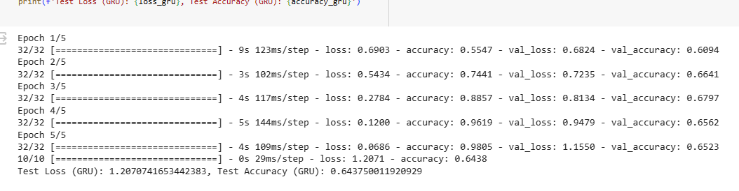
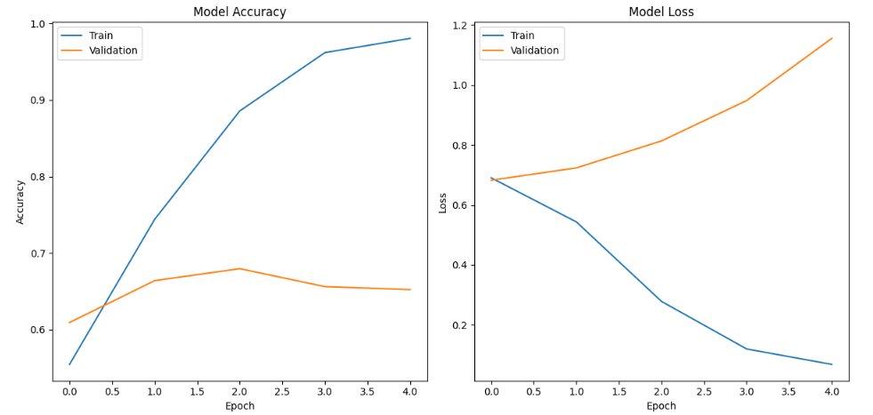
GRU- Gated Recurrent Unit

Slide 30
Neural Network Models- Comparison
Model (best one for each) | Test accuracy
Kmeans with CNN | 0.50
CNN | 0.80
LSTM | 0.74
GRU | 0.64

Slide 31
Conclusion
As shown before, ridge regression performs better than other regression models with accuracy 88%
Fuzzy C Means with KNN and Multinomial Naive Bayes gives good accuracy compared to other clustering and classifier models- 85%
CNN performs better with 80% accuracy compared to other neural networks.

